Slide 1
Anesthetic Monitoring
Clinical monitoring
Pulseoxymetry
Capnography
Non invasive Blood pressure
ECG
Peripheral nerve stimulators
Volatile / gas analyser & anaesthesia depth
Temperature monitoring
Documentation
√
√
√

Slide 2
Chapter Six
Cardiovascular System Monitoring
Wosen A.
AAU

Slide 3
1. Non invasive arterial blood pressure (NIABP) measurement

Slide 4
Non-invasive blood pressure monitoring
Manual sphygmomanometer
DINAMAP ( Device for Indirect Non-invasive Automatic Mean Arterial Pressure)
Finapres™

Slide 5
Non-invasive blood pressure monitoring
Manual sphygmomanometer
What information does it give?
Systolic/diastolic blood pressure
Intermittent monitoring
How does it work
Cuff inflated above systolic BP
Controlled deflation (3 mmHg / sec)
Korotkoff sounds

Slide 6
Non-invasive blood pressure monitoring
Manual sphygmomanometer
Limitations
Labour intensive
Requires good access
Difficult in noisy environment
Benefits
Cheap
No power needed
Sources of error
Operator dependent
Small cuff -> over-reads
Large cuff -> under-reads

Slide 7
Non-invasive blood pressure monitoring
DINAMAP
What information does it give?
Systolic + MAP
Intermittent monitoring
Components
Cuff with tubing for inflation
Case with microprocessor and pressure
transducer
Case also houses display and timing mechanism

Slide 8
Non-invasive blood pressure monitoring
DINAMAP
How does it work?
Oscillometry
Microprocessor controls sequence inflation and deflation
Cuff inflates to pressure above previous systolic
Cuff deflates incrementally – return of blood flow causes
oscillation in cuff pressure -> detected by transducer
MAP
Signal from cuff
Systolic
Diastolic
Time (or decreasing cuff pressure)

Slide 9
Non-invasive blood pressure monitoring
DINAMAP
How does it work?
Onset rapidly increasing oscillations = systolic pressure
Maximum oscillation = MAP
Diastolic = MAP – (1/2 difference between
MAP and systolic)
Cuff must be 2/3 upper arm & 40% mid circumference
MAP = Diastolic + 1/3 pulse pressure
Fast cuff inflation required to avoid venous congestion
Slow cuff deflation required to detect arterial pulsation

Slide 10
Non-invasive blood pressure monitoring
DINAMAP
Limitations
Small cuff –> false high BP (greater error)
Large cuff –> false low BP
Hypotension –> systolic over-reads
Hypertension –> systolic under-reads
AF and arrhythmias will affect performance
External pressure will cause inaccuracies
Risks
Pain
Limb oedema (avoid if axillary lymph node clearance)
Ulnar nerve palsy
Petechial haemorrhage on skin

Slide 11
Non-invasive blood pressure monitoring
DINAMAP
Costs
Expensive if part of integrated monitor
Benefits
Labour saving
Regular intervals
More reproducible than manual BP
Less problems with access to a limb

Slide 12
Non-invasive blood pressure monitoring
Finapres™
What information does it give?
Continuous blood pressure measurement
Components
Finger cuff, oscillometer and control unit
How does it work?
Assesses beat-to-beat blood pressure via oscillations in finger cuff which is automatically inflated and deflated
Limitations
Novel
Limited clinical experience
Research tool
Benefits
Only potential method for non-invasive beat-to-beat BP measurement

Slide 13
Anesthetic Monitoring
Clinical monitoring
Pulseoxymetry
Capnography
Non invasive Blood pressure
ECG
Peripheral nerve stimulators
Volatile / gas analyser & anaesthesia depth
Temperature monitoring
Documentation
√
√
√
√

Slide 14
2. Electrocardiography (ECG)

Slide 15
Objectives
Define ECG
Describe the working/ operating mechanism/ principles of ECG (Electrocardiogram)
Analyze steps to interpret an ECG report
Interpret normal ECG wave using the five steps
Interpret abnormal ECG waves using the five steps

Slide 16
Electrocardiography
What information does it give?
Continuous trace of electrical activity of whole heart
Provides continuous information about heart rate, presence of arrhythmias, ischaemia and conduction defects
ECG gives NO information about cardiac output
e.g. “Pulseless electrical activity” (PEA); ECG may look normal, but NO cardiac output

Slide 17
Electrocardiography (cont)
Components continued
Connection
An ECG skin electrode
Ag / AgCl electrode
Adhesive mount
Skin
Conductive gel
It is difficult to get a good reading without using ECG electrodes (‘dots’)
Notes:
Ag-silver

Slide 18
Electrocardiography (cont)
Position of electrodes for a 3-lead ECG:
Electrode
NOTE: the electrodes are generally colour coded;
Red – Right arm / shoulder
YelLow – Left arm / shoulder
Green – lower left chest (LeG)

Slide 19
Electrocardiography (cont)
For a monitoring ECG, only 3 electrodes are used,
so only 3 leads are possible
I
II
III
Note: on monitors in the OR, the ECG is generally set to Lead II
(Sometimes, if Lead II gives a poor trace, a useful trace can be seen on Lead I or III)

Slide 20
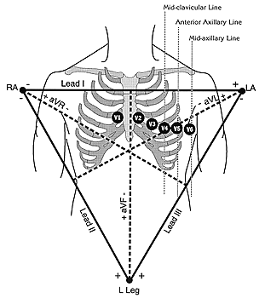
The 12-Leads
The 12-leads include:
3 Limb leads (I, II, III)
3 Augmented leads (aVR, aVL, aVF)
6 Precordial leads (V₁- V₆)

Slide 21
Electrocardiography (cont)
So, what do the ‘leads’ represent?
Leads V1 – V6 predominantly represent electrical activity of the ventricles
V1, 2 : Right ventricle
V3, 4 : interventricular septum
V5, 6 : Left ventricle
in 12-lead ECGs only
This allows ‘patterns’ to be recognised, to give an anatomical description to ECG changes
Examples:
II, III & aVF → ‘Inferior’
V2 & V3 → ‘Anterior’
V3 & V4 → ‘Septal’
V5 & V6 → ‘Lateral’

Slide 22
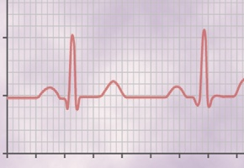
Electrocardiography (cont)
0.5 cm grid (with 1 mm small squares)
What does a basic trace look like?
R
Q
S
P wave – represents atrial depolarisation
QRS complex – represents ventricular depolarisation
NOTE:
Ventricular depolarisation is ‘inwards’ (towards endocardium), but repolarisation is ‘outwards’ so T waves are positive (like QRS complex)
T wave – represents ventricular repolarisation
Note: atrial repolarisation is rarely seen

Slide 23
Electrocardiography (cont)
Why does a trace look like this?
(2) A schematic of cardiac conduction
LA
Bundle of His
SA node
Ventricular conduction → QRS complex
Onset of AP → P wave
RA
Purkinje fibres
LV
AV node
AVN delays conduction between atria and ventricles → PR interval
RV
Larger left ventricle dominates; R waves are largest in V3 – V6

Slide 24
Electrocardiography (cont)
NOTE:
Long rhythm strip at bottom is usually lead II
A normal 12-lead ECG
I
aVR
V1
V4
II
aVL
V5
V2
III
aVF
V6
V3
Standard lead layout, standard paper speed and scale
Normal axis; QRS mainly positive in lead II

Slide 25
Electrocardiography (cont)
What information can be derived from a 3–lead ECG?
(1) Rate
(2) Rhythm
(3) Conduction abnormalities
Better seen on a 12–lead ECG, but can be picked up on 3–lead ECGs
(4) Signs of ischaemia
Again, better picked up on a 12–lead ECG

Slide 26
Electrocardiography (cont)
What information can be derived from a 3–lead ECG?
(1) Rate
ECG paper has 5 small squares (1 mm) per large square (of 0.5 cm)
0.5 cm
0.5 cm
The standard paper rate is 25 mm / s
The standard voltage response is 1 mV / cm, so:
0.04 s
0.5 mV
0.2 s

Slide 27
Electrocardiography (cont)
What information can be derived from a 3–lead ECG?
(1) Rate (cont.)
Example:
Each large square represents 0.2 s
There are 60 s / min, so an ECG covers 300 large squares / min
so, if there is a beat every 5 large squares;
rate = 300 = 60 / min
5
Generally:
Rate = [ 300 / number of large squares between beats ]
(in beats per minute)

Slide 28
Electrocardiography (cont)
What information can be derived from a 3–lead ECG?
(1) Rate (cont.)
So, what is the rate here?
Option 1, Rate = [ 300 / number of large squares between beats ] (in beats per minute)
= [ 300 / 4.6 ]
beats per minute
((4 large and 3 small squares))
= 65 beats per minute

Slide 29
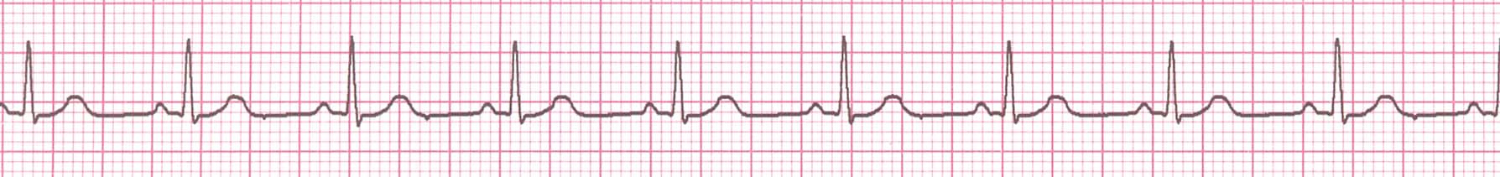
Electrocardiography (cont)
What information can be derived from a 3–lead ECG?
(1) Rate (cont.)
Example, what is the rate here?
Rate = [ 300 / number of large squares between beats ] (in beats per minute)
= [ 300/ 3.3 ]
beats per minute
= 90 beats per minute

Slide 30
Electrocardiography (cont)
What information can be derived from a 3–lead ECG?
(1) Rate (cont.)
So, what is the rate here?
3 sec
3 sec
Option 2, Rate = Count the number of R waves in a 6 second rhythm strip, then multiply by 10, (in beats per minute)
= [ 9 x 10 ]
beats per minute
= 90 beats per minute

Slide 31
Electrocardiography (cont)
What information can be derived from a 3–lead ECG?
(2) Rhythm
Is it ‘sinus rhythm’?
- are P waves and QRS complexes always seen together?
Is it regular or irregular?
- mark R-R interval on a piece of paper and move it along ECG; is the interval consistent?
Is the PR interval prolonged?
- this should be ≤ 0.2 s (i.e. ≤ 5 small squares)
[NOTE: this is from start of P to start of QRS]
Is the QRS complex broad?
- this should be ≤ 0.12 s (i.e. ≤ 3 small squares)
these are best shown by example…

Slide 32
Electrocardiography (cont)
Normal sinus rhythm
what is the rate?
approx. 90 bpm,
Is it sinus rhythm?
Yes, Regular
What is the PR interval?
< 0.2 s (normal)
What is the QRS duration?
< 0.12 s (normal)

Slide 33
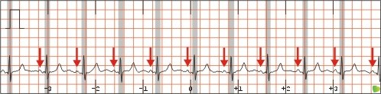
Electrocardiography (cont)
Normal sinus rhythm
what is the rate?
approx. 75 bpm
Is it sinus rhythm?
yes
What is the PR interval?
< 0.2 s (normal)
What is the QRS duration?
< 0.12 s (normal)

Slide 34
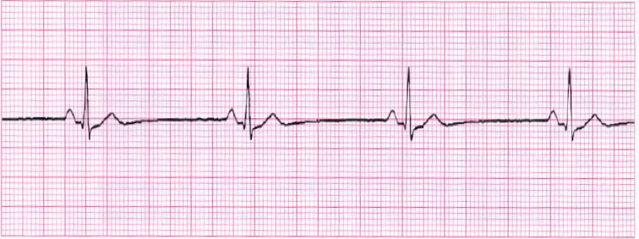
Electrocardiography (cont)
Sinus bradycardia
what is the rate?
approx 38 bpm
Is it sinus rhythm?
yes
What is the PR interval?
< 0.2 s (normal)
What is the QRS duration?
< 0.12 s (normal)

Slide 35
Electrocardiography (cont)
Causes of sinus bradycardia
Fit and healthy adult
Hypoxia (especially in children)
Vagal stimulation
Cardiac disease
Drugs (eg suxamethonium, beta-blockers, etc.)
Brief over-view of treatment
O₂
Treat underlying cause (e.g stop surgical stimulus)
Anticholinergic (e.g. atropine, or glycopyrolate)
Consider adrenaline if resistant
Note: beta-blocked patients may respond to glucagon

Slide 36
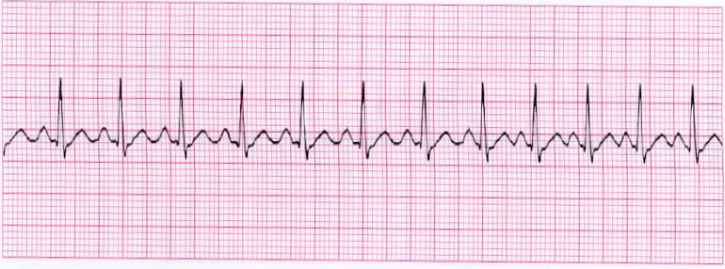
Electrocardiography (cont)
Sinus tachycardia
what is the rate?
Approx 120 bpm
Is it sinus rhythm?
yes
What is the PR interval?
< 0.2 s (normal)
What is the QRS duration?
< 0.12 s (normal)

Slide 37
Electrocardiography (cont)
Causes of sinus tachycardia
Inadequate anaesthesia
Pain
Fever / sepsis
Hypovolaemia
Anaemia
Heart failure
Thyrotoxicosis
Drugs (including ketamine, atropine)
Anaphylaxis
Pulmonary embolism
etc…
Brief over-view of treatment
O₂
Treat underlying cause

Slide 38
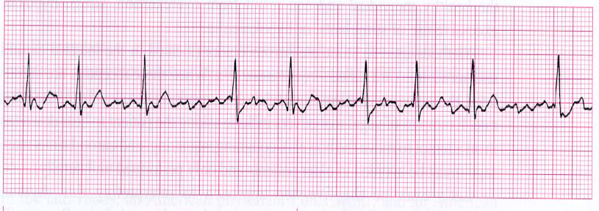
Electrocardiography (cont)
Atrial fibrillation (“AF”)
what is the rate?
variable; average 80 (ventricular)
Is it sinus rhythm?
no; irregular & no P wave:QRS relationship
What is the PR interval?
unknown
What is the QRS duration?
< 0.12 s (normal)

Slide 39
Electrocardiography (cont)
Causes of atrial fibrillation (“AF”)
Electrolyte disturbances
Sepsis
Thyrotoxicosis
Excessive sympathetic stimulation
Mitral valve disease
Pericarditis
Hypertension
Ischaemia
Alcohol
Caffeine
Thoracic surgery
Brief over-view of treatment
O₂
Treat underlying cause
Depending on duration, consider
- electrical cardioversion (synchronised)
- chemical cardioversion (eg amiodarone)
- rate control (eg digoxin)
- consider anticoagulation

Slide 40
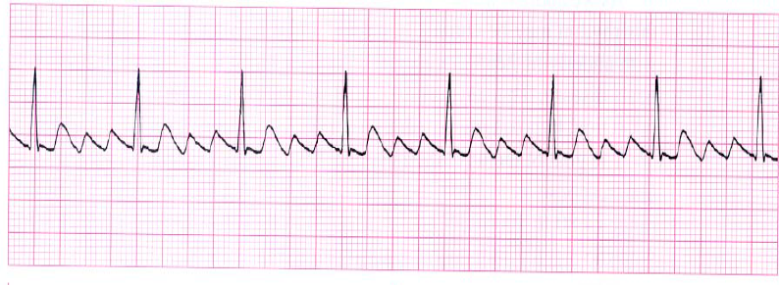
Electrocardiography (cont)
Atrial flutter
what is the rate?
approx 75 bpm
Is it sinus rhythm?
no
What is the PR interval?
no normal P waves
What is the QRS duration?
< 0.12 s (normal)

Slide 41
Electrocardiography (cont)
Causes of atrial flutter
As for atrial fibrillation
Brief over-view of treatment
O₂
Treat underlying cause
Depending on duration, consider
- electrical cardioversion (synchronised)
- chemical cardioversion (seek expert advice)
- rate control (seek expert advice)
- consider anticoagulation

Slide 42
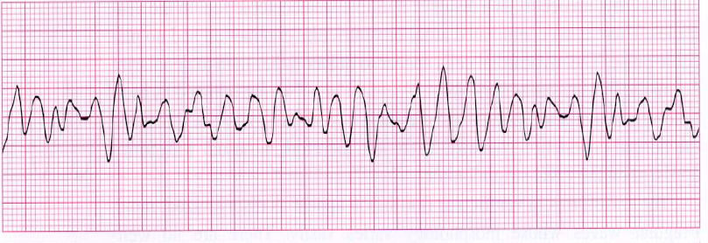
Electrocardiography (cont)
NOTE:
This is incompatible with a viable cardiac output
Ventricular fibrillation (“VF”)
what is the rate?
completely chaotic
Is it sinus rhythm?
no
What is the PR interval?
unknown
What is the QRS duration?
unrecognisable

Slide 43
Electrocardiography (cont)
REVERSIBLE causes of VF (from ALS algorithm)
The 4 ‘H’s and 4 ‘T’s
Hypoxia
Hypovolaemia
Hyper/hypokalaemia
Hypothermia
Tension pneumothorax
Tamponade
Thrombo-embolism
Toxic (eg drugs)
Brief over-view of treatment
Advanced Life Support algorithm (ALS)
Identify and treat cause appropriately

Slide 44
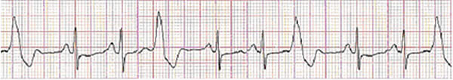
Electrocardiography (cont)
NOTE:
These require experience to recognise
Ventricular Ectopics (“VEs”)
what is the rate?
Approx 100 bpm
Is it sinus rhythm?
yes; but with superimposed abnormal QRS complexes
What is the PR interval?
< 0.2 s (normal)
What is the QRS duration?
< 0.12 s (normal) … except for the abnormal complexes

Slide 45
Electrocardiography (cont)
Causes of ventricular ectopics
Idiopathic
Electrolyte disturbance
Halothane
Light anaesthesia
Raised CO₂
Surgical stimulation
Brief over-view of treatment
If no structural heart disease, these are usually benign
Treat underlying cause
(could consider low dose beta-blocker)
If the P waves are slow, ectopic beats may be ‘ventricular escape beats’ (consider atropine)

Slide 46
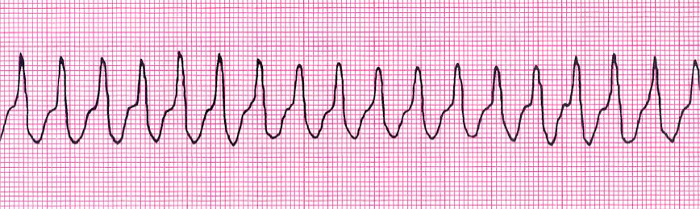
Electrocardiography (cont)
Ventricular tachycardia (“VT”)
NOTE:
This requires urgent treatment
what is the rate?
Approx 167 bpm
Is it sinus rhythm?
no (no P waves, but fairly regular (abnormal) QRS complexes)
What is the PR interval?
not known
What is the QRS duration?
‘broad’; > 0.12 s

Slide 47
Electrocardiography (cont)
Causes of ventricular tachycardia (“VT”)
This is an EMERGENCY!
Myocardial ischaemia
Hypoxia
Hypotension
Fluid overload
Electrolyte imbalance
Adrenaline (or other catecholamines)
Brief over-view of treatment
Call for ‘HELP’
If pulseless; as for ALS algorithm
If unstable; DC cardioversion
If stable; consider amiodarone (expert advice required urgently)

Slide 48
Electrocardiography (cont)
What information can be derived from a 3–lead ECG?
(3) Conduction abnormalities
There are many possible sites of conduction abnormality
Slow:
Atrial / AV node
Bundle of His
Left or right bundles
Conducting fascicles
Aberrant (i.e. pathways which should not be there)
We will concentrate on AV node conduction problems (which are the most common)

Slide 49
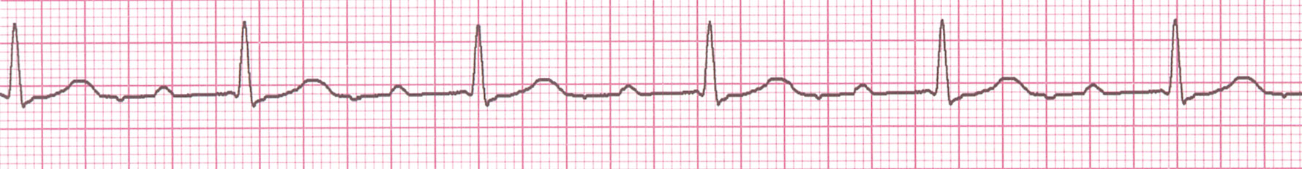
Electrocardiography (cont)
First degree heart block (“1st DHB”)
what is the rate?
Approx 60 bpm
Is it sinus rhythm?
yes
What is the PR interval?
> 0.2 s (prolonged)
What is the QRS duration?
< 0.12 s (normal)

Slide 50
Electrocardiography (cont)
Causes of 1st DHB
Idiopathic (benign)
Prolonged conduction delay in the AV node or Bundle of His.
Brief over-view of treatment
None required in the absence of symptoms

Slide 51
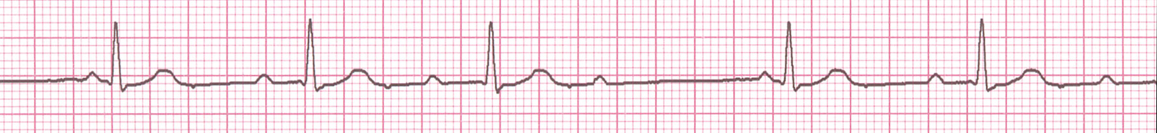
Electrocardiography (cont)
Second degree heart block (Mobitz Type I / Wenkebach)
NOTE:
The PR interval increases with successive beats, until a QRS is missed
what is the rate?
Background of 60 bpm with missed beats
Is it sinus rhythm?
yes, but with some missed QRS complexes
What is the PR interval?
prolongs with each successive beat
What is the QRS duration?
< 0.12 s (normal)

Slide 52
Electrocardiography (cont)
Causes of 2nd DHB, Mobitz Type I
Post-myocardial infarction (especially inferior MI)
Any structural heart disease
Brief over-view of treatment
Usually self-limiting (no treatment required for arrhythmia)
(Treat underlying cause)

Slide 53
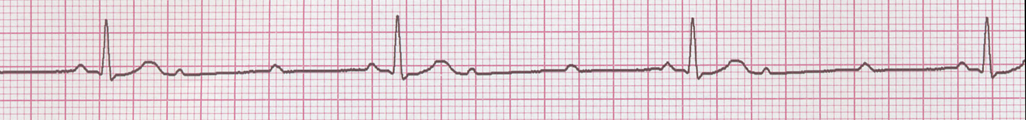
Electrocardiography (cont)
NOTE:
Conduction is all or nothing (no prolongation of PR interval); typically block occurs in the Bundle of His.
Conduction ratio (P waves to QRS complexes) is commonly 2:1, 3:1, or 4:1.
Second degree heart block
(Type II )
what is the rate?
Background of 40, regular
Is it sinus rhythm?
yes, but with some missed QRS complexes & P, 2/3 Ps without QRS
What is the PR interval?
< 0.2 s (Normal)
What is the QRS duration?
< 0.12 s (normal)

Slide 54
Electrocardiography (cont)
Causes of 2nd DHB,
Myocardial ischaemia
Structural heart disease
Brief over-view of treatment
Pre-operative: expert advice
Consider pacing wire

Slide 55
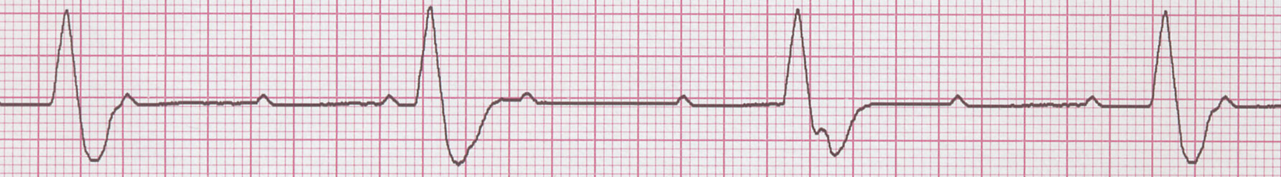
Electrocardiography (cont)
NOTE:
-Conduction between atria and ventricles is absent because of electrical block at or below the AV node.
Complete heart block (“CHB”)
what is the rate?
Approx 30 bpm, but atrial 60-100bpm
Is it sinus rhythm?
no (no relationship between P and QRS)
What is the PR interval?
no relationship
What is the QRS duration?
~ 0.12 s (borderline prolonged)

Slide 56
Electrocardiography (cont)
Causes of complete heart block (“CHB”)
Myocardial ischaemia
Structural heart disease
(rarely; vagal stimulation
congenital)
Brief over-view of treatment
Stop vagal stimulation
Try atropine
Expert help
Pacemaker

Slide 57
Electrocardiography (cont)
What information can be derived from a 3–lead ECG?
(4) Signs of ischaemia (a brief overview)
Ischaemic changes (cell hypoxia / hypoperfusion)
ST depression
T wave inversion
Possible rhythm disturbance (may be cause or effect)
Acute signs of infarct (cell death)
ST elevation
T wave inversion
New conduction abnormalities
Q waves (after a few hours)
Arrhythmias
Signs of a previous infarct (mature changes)
Q waves
Flattened T waves
Persistent conduction abnormalities

Slide 58

Electrocardiography (cont)
So, this is sinus tachycardia, but WHAT ELSE is going on??
what is the rate?
approx 150 bpm
Is it sinus rhythm?
yes
What is the PR interval?
hard to see (but normal)
What is the QRS duration?
< 0.12 s (normal)

Slide 59
Electrocardiography (cont)
NOTE:
The pattern of the ischaemic changes in different leads indicates which region of the heart is affected
Myocardial ischaemia
(THIS IS THE SAME ECG AS THE PREVIOUS SLIDE)
Do the QRS complexes look normal?
yes
Do the ST segments look normal?
What is wrong with them?
There is marked “ST depression”

Slide 60
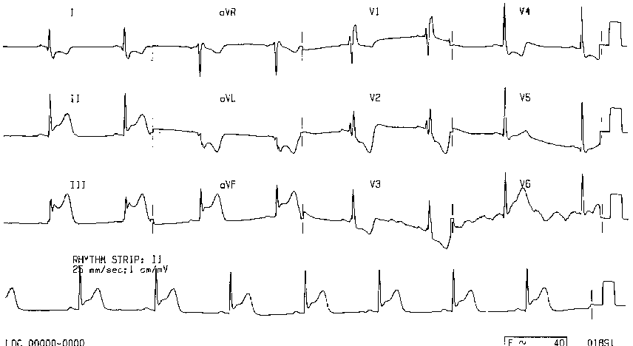
Electrocardiography (cont)
NOTE:
There is ST depression (ischaemia) in other leads
Acute myocardial infarction (“MI”)
How do we know it’s an MI?
ST elevation
Which leads are involved?
II, III and aVF
Where is the infarction?
Inferior MI

Slide 61
Electrocardiography (cont)
Disconnection / equipment failure
This is representation; not an actual recording
How would you describe the trace?
Completely flat

Slide 62
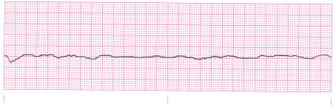
Electrocardiography (cont)
NOTE:
Although this is known as a ‘flatline’ in films, it is NOT a completely flat line!
Asystole
How would you describe the trace?
no cardiac activity seen

Slide 63
Electrocardiography (cont)
REVERSIBLE causes of asystole (from ALS algorithm)
The 4 ‘H’s and 4 ‘T’s
Hypoxia
Hypovolaemia
Hyper/hypokalaemia
Hypothermia
Tension pneumothorax
Tamponade
Thrombo-embolism
Toxic (eg drugs)
Brief over-view of treatment
Advanced Life Support algorithm (ALS)
Identify and treat cause appropriately

Slide 64
Anesthetic Monitoring
Clinical monitoring
Pulseoxymetry
Capnography
Non invasive Blood pressure
ECG
Peripheral nerve stimulators
Volatile / gas analyser & anaesthesia depth
Temperature monitoring
√
√
√
√
√

Slide 65
END!!!

